Slide 1
Regression Estimation – Least Squares and Maximum Likelihood
Dr. Frank Wood
TexPoint fonts used in EMF.
Read the TexPoint manual before you delete this box.: AAAAAAAAA

Slide 2
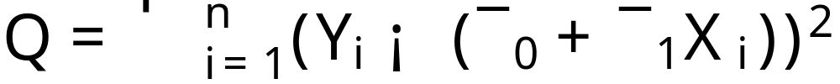
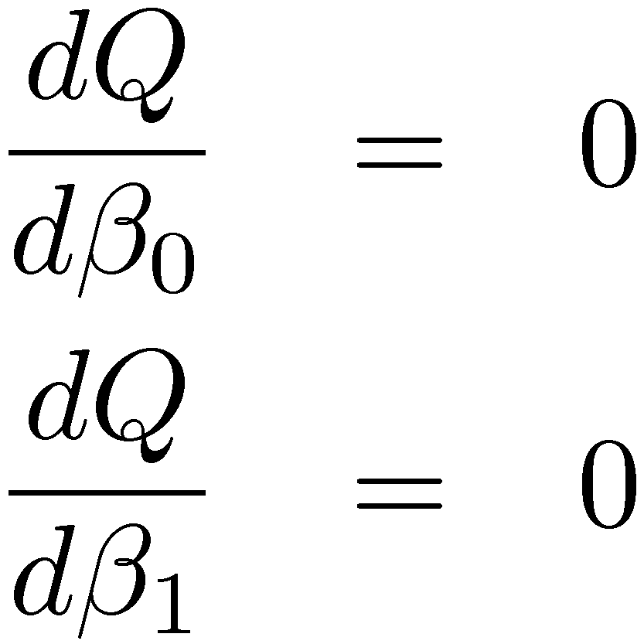
Least Squares Max(min)imization
Function to minimize w.r.t. ¯₀, ¯₁
Minimize this by maximizing –Q
Find partials and set both equal to zero
go to board

Slide 3
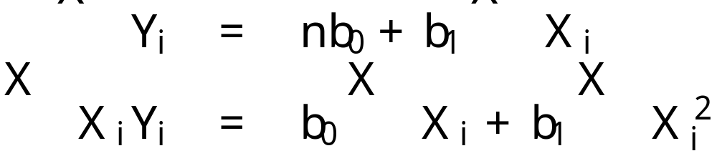
Normal Equations
The result of this maximization step are called the normal equations. b₀ and b₁ are called point estimators of ¯₀ and ¯₁ respectively
This is a system of two equations and two unknowns. The solution is given by…
Write these on board

Slide 4
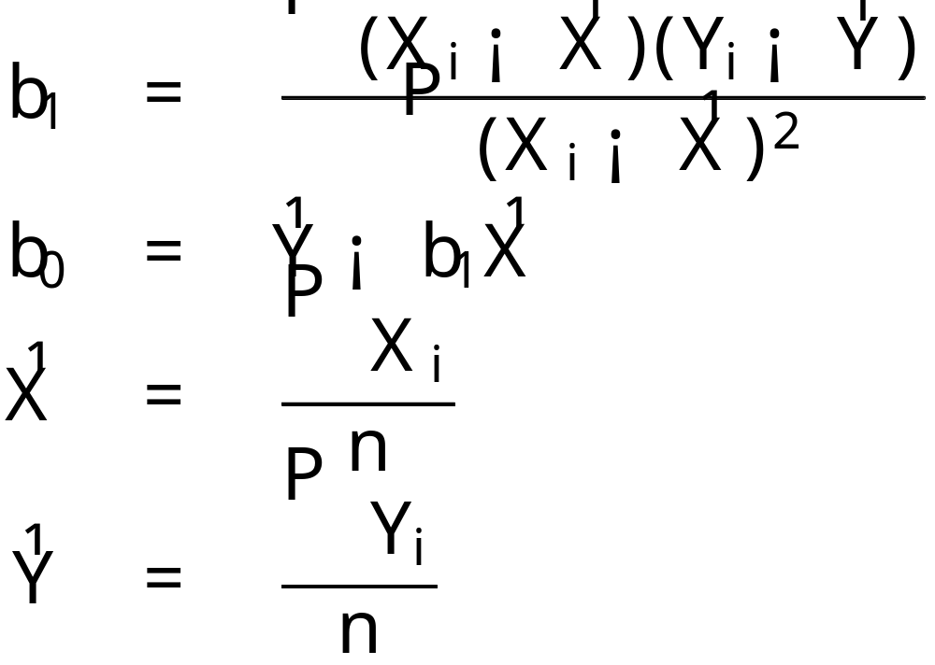
Solution to Normal Equations
After a lot of algebra one arrives at

Slide 5
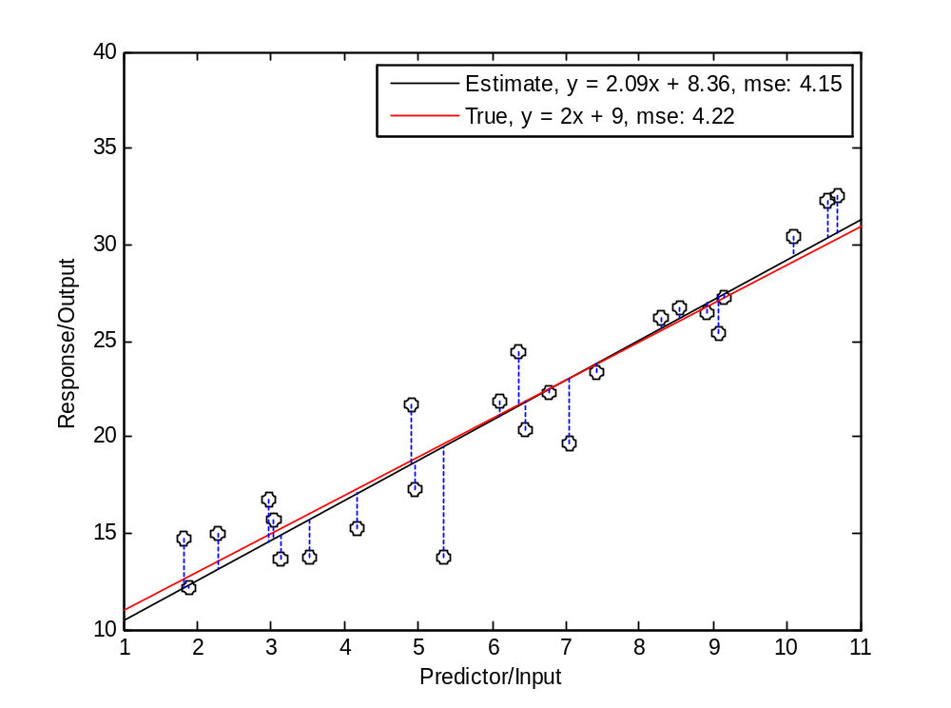
Least Squares Fit
?

Slide 6
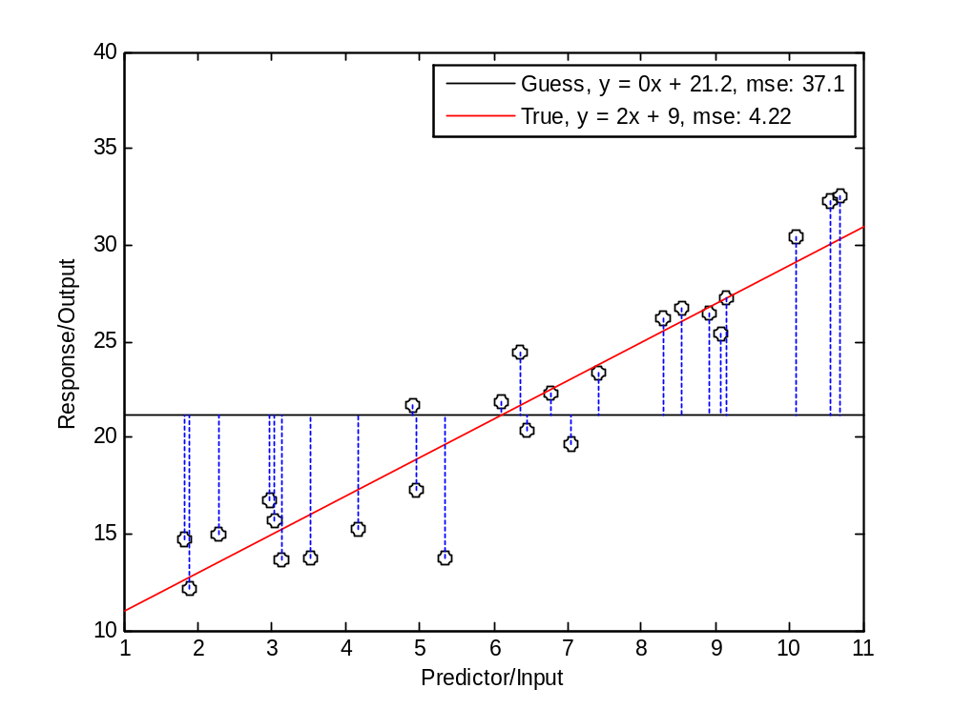
Guess #1

Slide 7
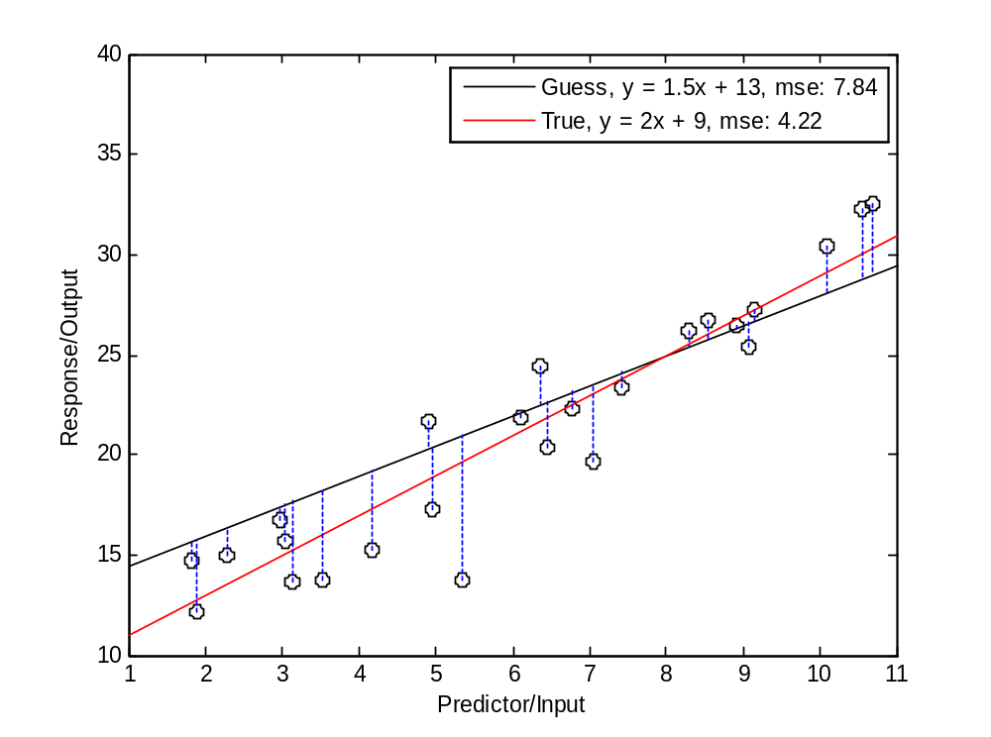
Guess #2

Slide 8
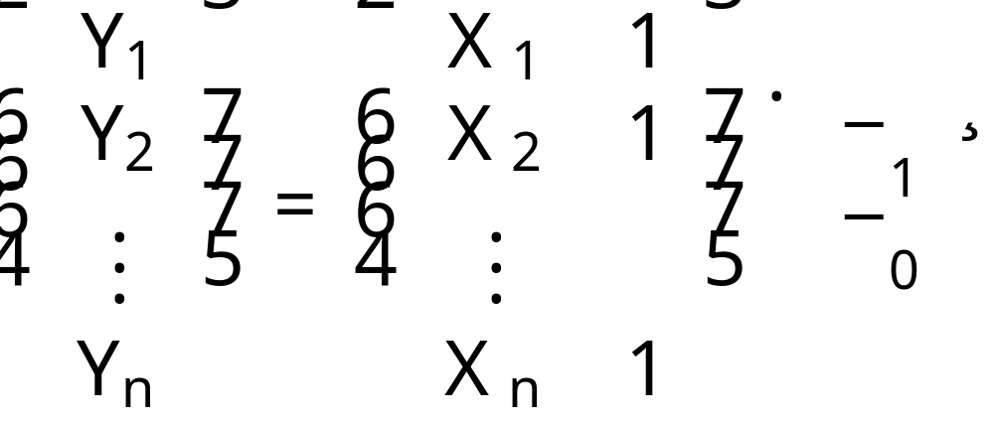
Looking Ahead: Matrix Least Squares
Solution to this equation is solution to least squares linear regression (and maximum likelihood under normal error distribution assumption)

Slide 9
Questions to Ask
Is the relationship really linear?
What is the distribution of the of “errors”?
Is the fit good?
How much of the variability of the response is accounted for by including the predictor variable?
Is the chosen predictor variable the best one?

Slide 10
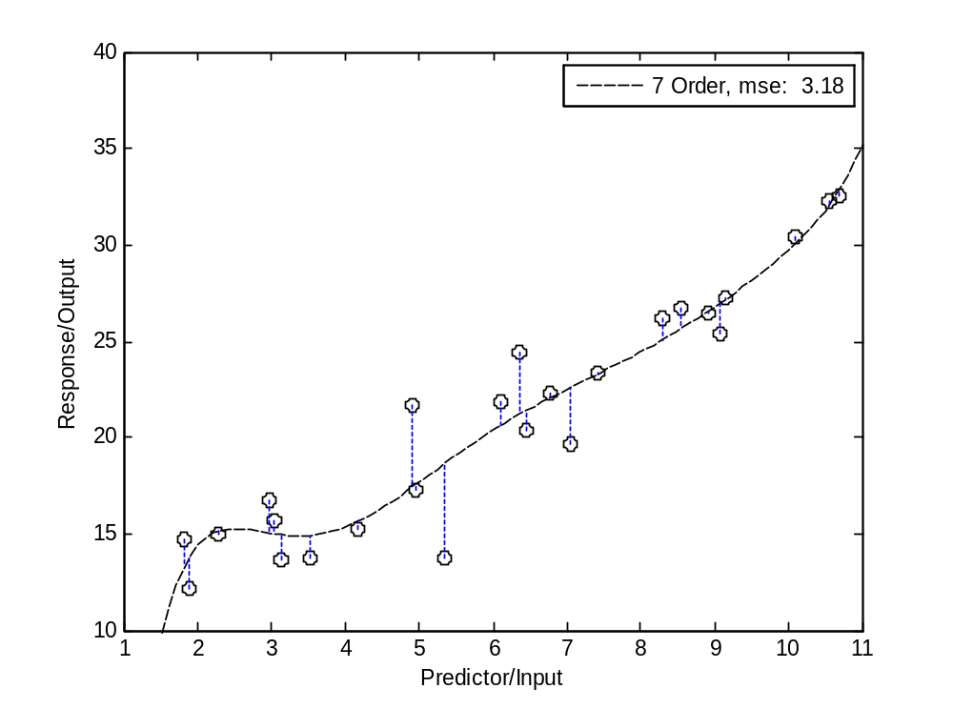
Is This Better?

Slide 11
Goals for First Half of Course
How to do linear regression
  Self familiarization with software tools
How to interpret standard linear regression results
How to derive tests
How to assess and address deficiencies in regression models

Slide 12
Estimators for ¯₀, ¯₁, ¾²
We want to establish properties of estimators for ¯₀, ¯₁, and ¾² so that we can construct hypothesis tests and so forth
We will start by establishing some properties of the regression solution.

Slide 13
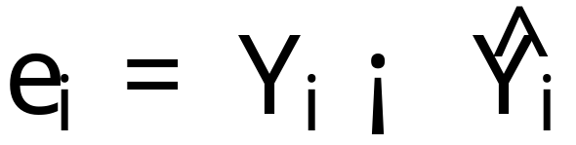
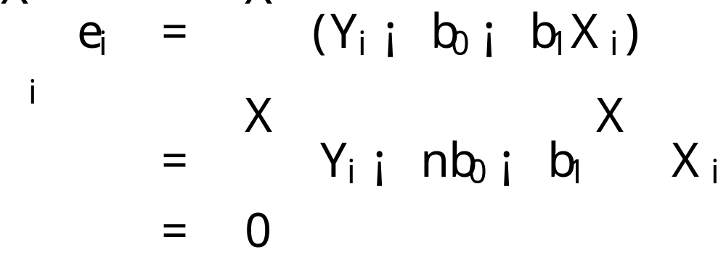
Properties of Solution
The i^{th} residual is defined to be
The sum of the residuals is zero:
By first normal equation.

Slide 14

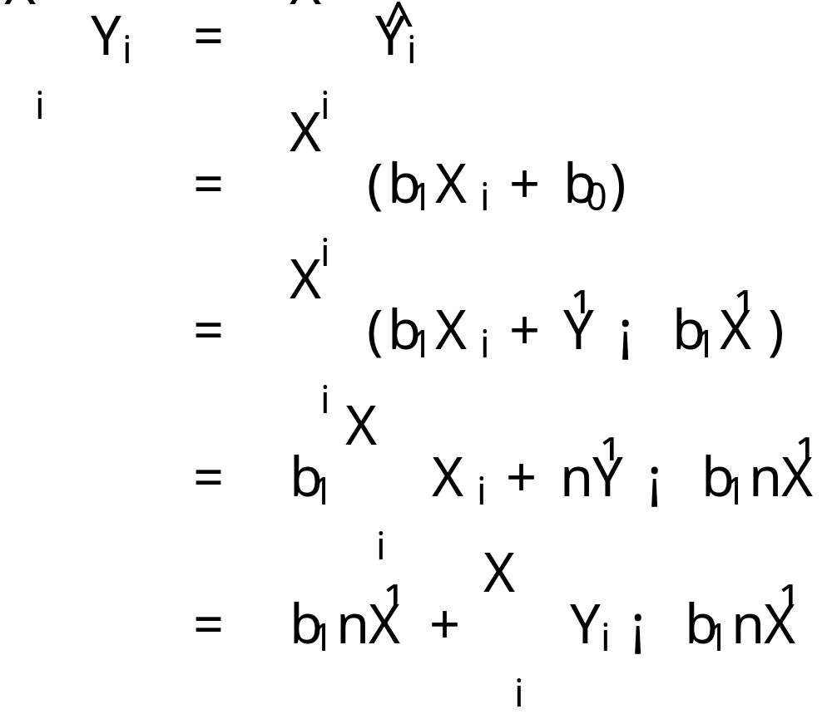
Properties of Solution
The sum of the observed values Y_{i} equals the sum of the fitted values

Slide 15
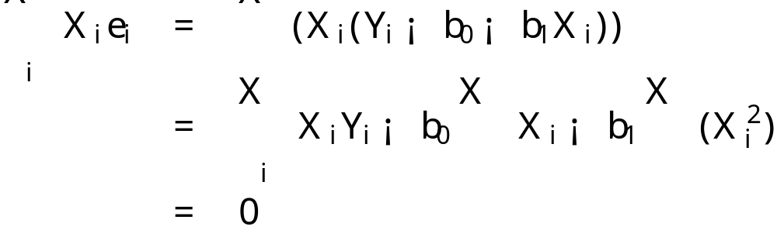
Properties of Solution
The sum of the weighted residuals is zero when the residual in the i^{th} trial is weighted by the level of the predictor variable in the i^{th} trial
By second normal equation.

Slide 16
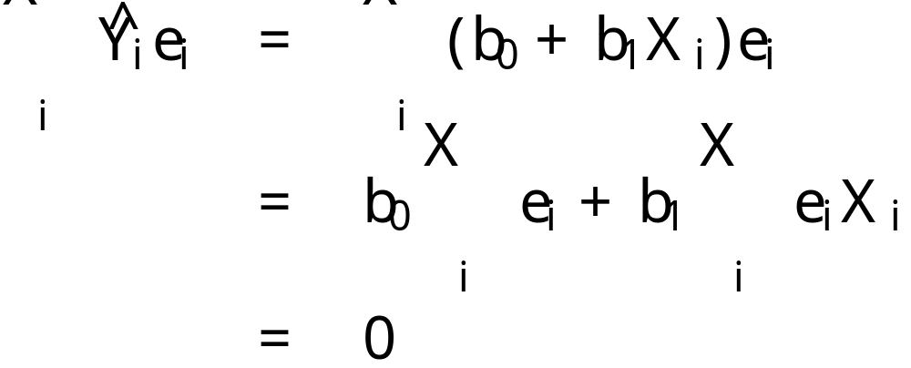
Properties of Solution
The sum of the weighted residuals is zero when the residual in the i^{th} trial is weighted by the fitted value of the response variable for the i^{th} trial
By previous properties.

Slide 17
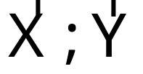
Properties of Solution
The regression line always goes through the point

Slide 18
Estimating Error Term Variance ¾²
Review estimation in non-regression setting.
Show estimation results for regression setting.

Slide 19
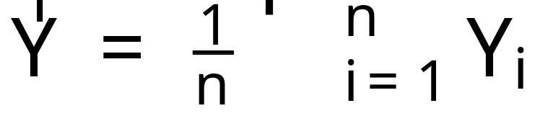
Estimation Review
An estimator is a rule that tells how to calculate the value of an estimate based on the measurements contained in a sample
i.e. the sample mean

Slide 20
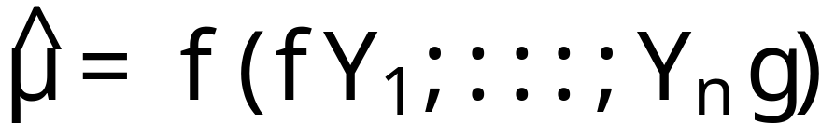

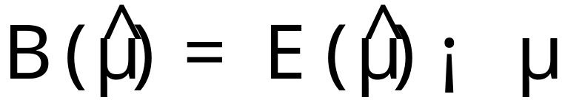
Point Estimators and Bias
Point estimator
Unknown quantity / parameter
Definition: Bias of estimator

Slide 21
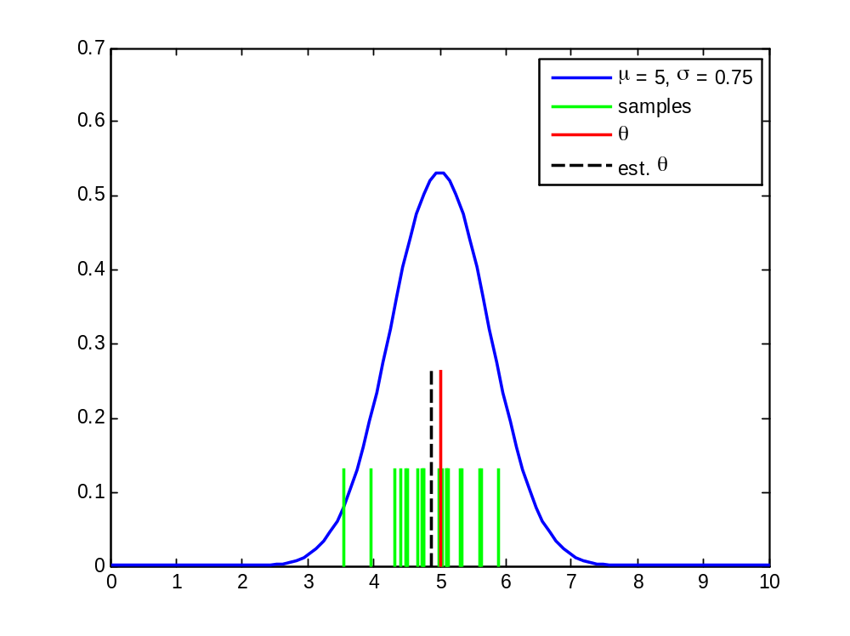
One Sample Example
run bias_example_plot.m

Slide 22
Distribution of Estimator
If the estimator is a function of the samples and the distribution of the samples is known then the distribution of the estimator can (often) be determined
  Methods
    Distribution (CDF) functions
    Transformations
    Moment generating functions
    Jacobians (change of variable)

Slide 23
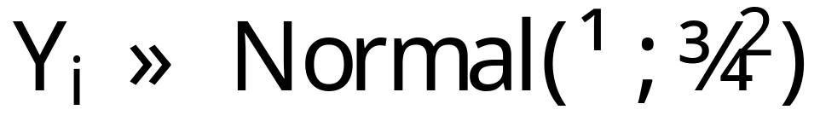
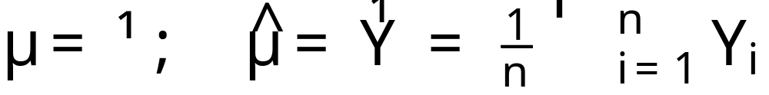
Example
Samples from a Normal(¹,¾²) distribution
Estimate the population mean

Slide 24
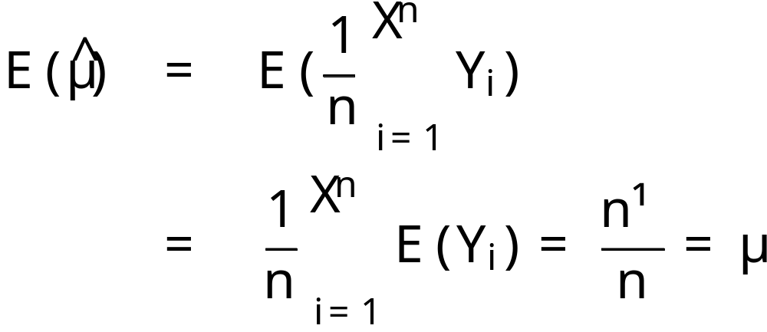
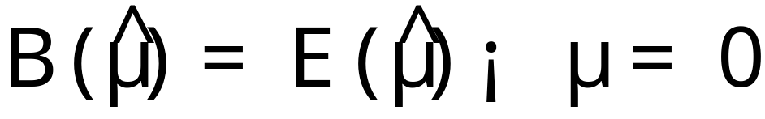
Sampling Distribution of the Estimator
First moment
This is an example of an unbiased estimator

Slide 25
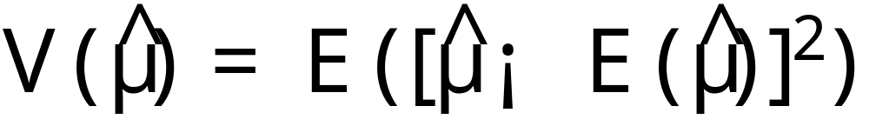
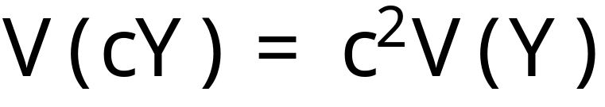
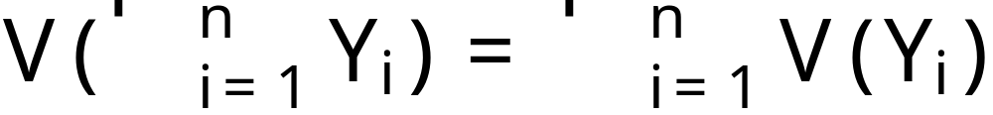
Variance of Estimator
Definition: Variance of estimator
Remember:
Only if the Y_{i} are independent with finite variance

Slide 26
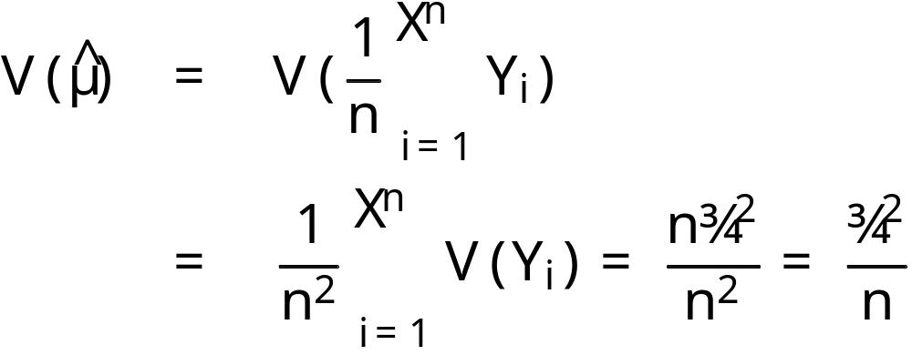
Example Estimator Variance
For N(0,1) mean estimator
Note assumptions

Slide 27
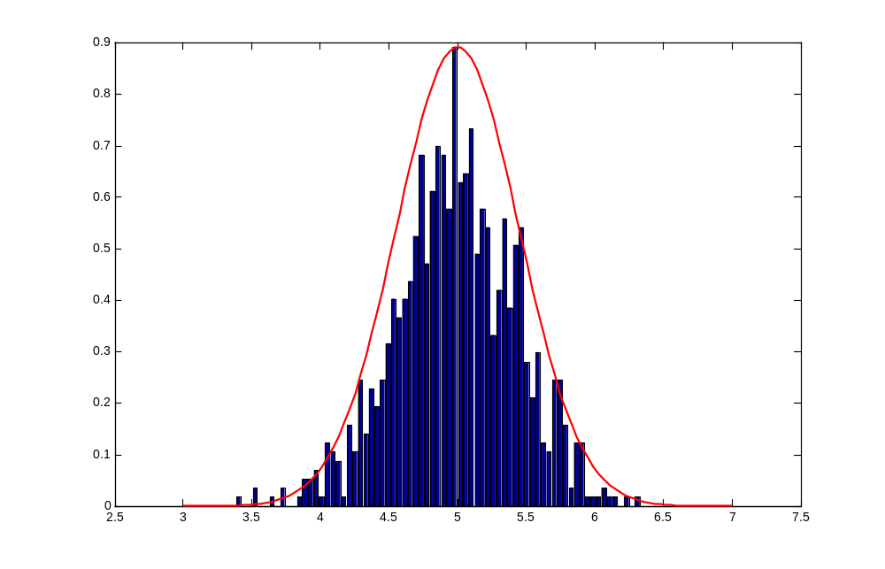
Distribution of sample mean estimator
1000 samples

Slide 28
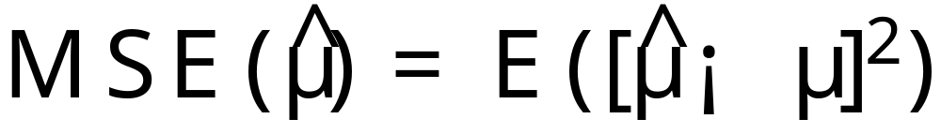
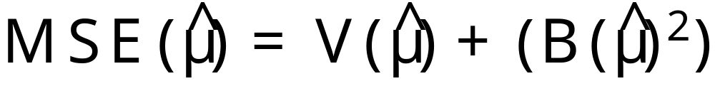
Bias Variance Trade-off
The mean squared error of an estimator
Can be re-expressed

Slide 29
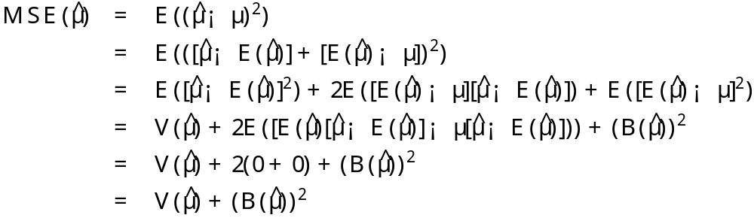
MSE = VAR + BIAS²
Proof

Slide 30
Trade-off
Think of variance as confidence and bias as correctness.
  Intuitions (largely) apply
Sometimes a biased estimator can produce lower MSE if it lowers the variance.

Slide 31
Estimating Error Term Variance ¾²
Regression model
Variance of each observation Y_{i} is ¾² (the same as for the error term ²_{i})
Each Y_{i} comes from a different probability distribution with different means that depend on the level X_{i}
The deviation of an observation Y_{i} must be calculated around its own estimated mean.

Slide 32
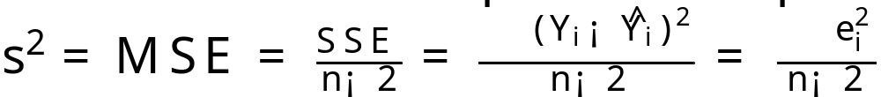
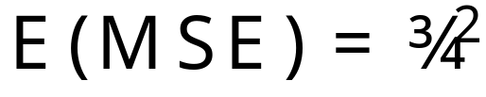
s² estimator for ¾²
MSE is an unbiased estimator of ¾²
The sum of squares SSE has n-2 degrees of freedom associated with it.

Slide 33
Normal Error Regression Model
No matter how the error terms ²_{i} are distributed, the least squares method provides unbiased point estimators of ¯₀ and ¯₁
  that also have minimum variance among all unbiased linear estimators
To set up interval estimates and make tests we need to specify the distribution of the ²_{i}
We will assume that the ²_{i} are normally distributed.

Slide 34

Normal Error Regression Model
Y_{i} value of the response variable in the i^{th} trial
¯₀ and ¯₁ are parameters
X_{i} is a known constant, the value of the predictor variable in the i^{th} trial
²_{i} ~_{iid} N(0,¾²)
i = 1,…,n

Slide 35
Notational Convention
When you see ²_{i} ~_{iid} N(0,¾²)
It is read as ²_{i} is distributed identically and independently according to a normal distribution with mean 0 and variance ¾²
Examples
  µ ~ Poisson(¸)
  z ~ G(µ)

Slide 36
Maximum Likelihood Principle
The method of maximum likelihood chooses as estimates those values of the parameters that are most consistent with the sample data.

Slide 37

Likelihood Function
If
then the likelihood function is

Slide 38
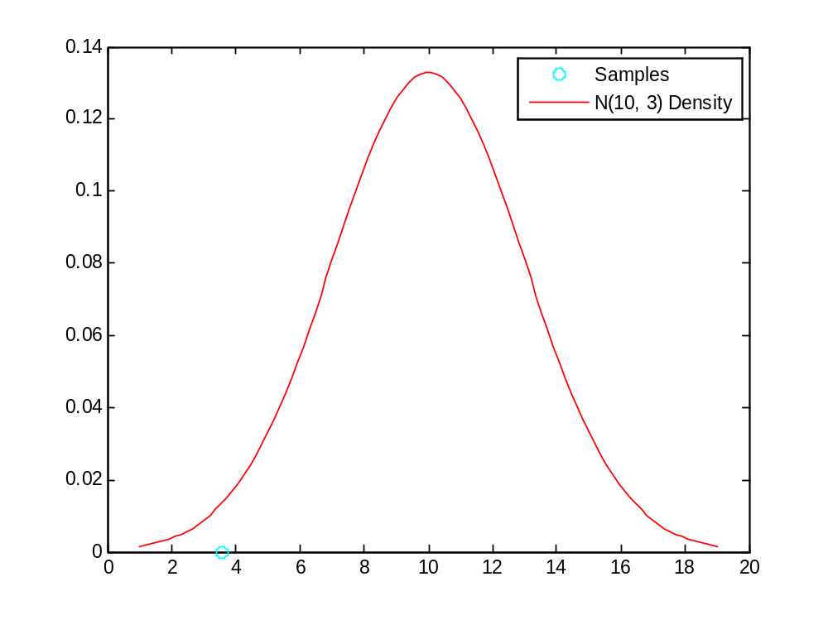
Example, N(10,3) Density, Single Obs.
N=10, - log likelihood = 4.3038

Slide 39
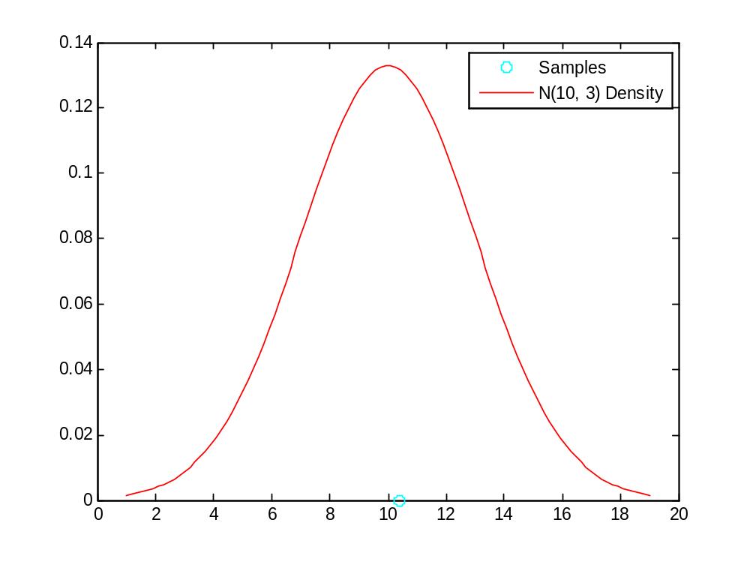
Example, N(10,3) Density, Single Obs. Again
N=10, - log likelihood = 4.3038

Slide 40
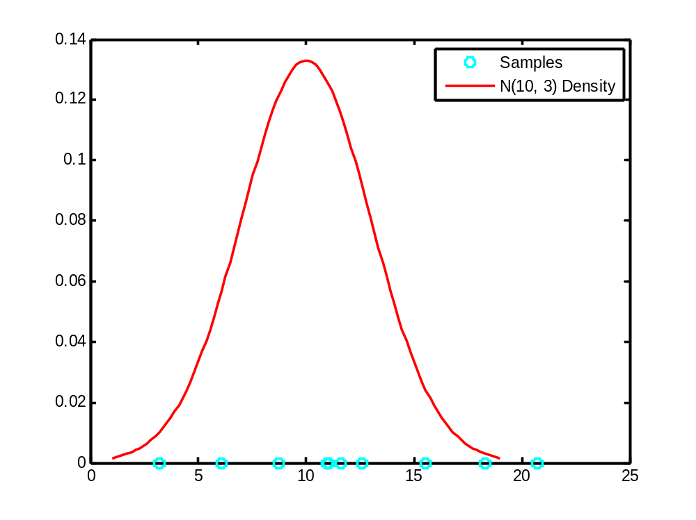
Example, N(10,3) Density, Multiple Obs.
N=10, - log likelihood = 36.2204

Slide 41
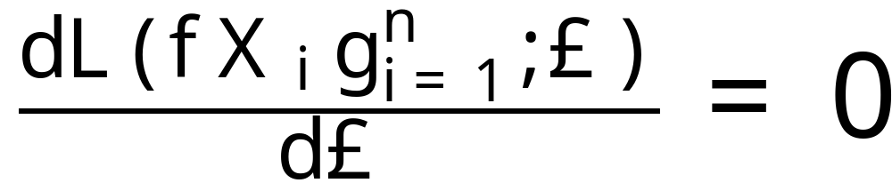
Maximum Likelihood Estimation
The likelihood function can be maximized w.r.t. the parameter(s) £, doing this one can arrive at estimators for parameters as well.
To do this, find solutions to (analytically or by following gradient)

Slide 42
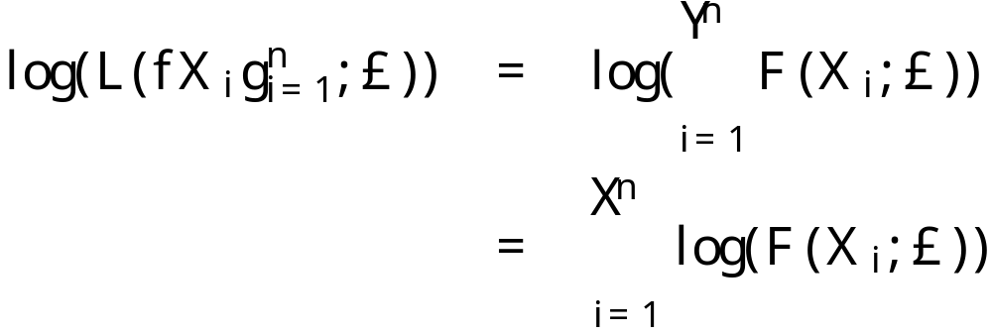
Important Trick
Never (almost) maximize the likelihood function, maximize the log likelihood function instead.
Quite often the log of the density is easier to work with mathematically.

Slide 43
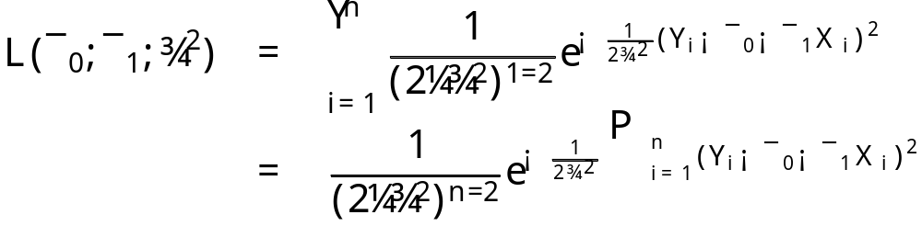
ML Normal Regression
Likelihood function
which if you maximize (how?) w.r.t. to the parameters you get…

Slide 44
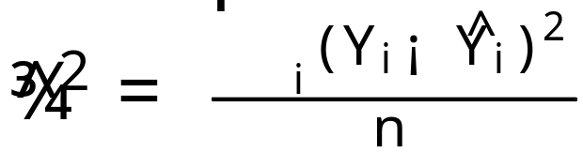
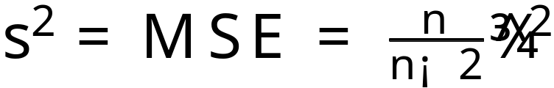
Maximum Likelihood Estimator(s)
¯₀
  b₀ same as in least squares case
¯₁
  b₁ same as in least squares case
¾₂
Note that ML estimator is biased as s² is unbiased and

Slide 45
Comments
Least squares minimizes the squared error between the prediction and the true output
The normal distribution is fully characterized by its first two central moments (mean and variance)
Food for thought:
  What does the bias in the ML estimator of the error variance mean? And where does it come from?

